Slide 1

Environmental Studies: Definition, Risk, and GMOs
Information Security Fundamentals | Introduction to environment and ecosystem
Course: Information Security Fundamentals | Chapter: Introduction to environment and ecosystem | Program: Bachelor of Engineering
DISCOVER · LEARN · EMPOWER
Notes:
Welcome to today's lecture on the foundational concepts of Environmental Studies. We will explore the definition, scope, and the critical role of risk assessment in our ecosystem. We will also dive into the significance of genetically modified organisms and the emerging market for environmental solutions. Remember, this knowledge is vital for your engineering practice.

Slide 2
Course Outcomes
SLIDE 2 / 14
Course Outcome
CO | BT LEVEL | DESCRIPTION
CO1 | BT4 | Recall, analyze and respond on fundamental environmental principles, such as ecological relationships and conservation strategies
CO2 | BT4 | Understand and analyze the interconnections between human activities and environmental impacts across different ecosystems
CO3 | BT4 | Understand and analyze and apply environmental laws and policies to analyse and propose solutions for real-world environmental challenges.
CO4 | BT2 | Students will analyse data from environmental monitoring programs to assess trends and predict future impacts on ecosystems.
CO5 | BT6 | Interpret, elaborate and propose various tools, design and innovative strategies for sustainable development and environmental conservation initiatives in securing the planet.
Chandigarh University
2 / 14
Notes:
This lecture directly addresses Course Outcome 1, which requires you to recall and analyze fundamental environmental principles. You will learn to identify ecological relationships and understand conservation strategies through the lens of risk assessment. By the end of this session, you will be able to respond to environmental challenges with analytical rigor.

Slide 3
Learning Objectives
SLIDE 3 / 14
Learning Outcomes
1
Define Environmental Studies and articulate its multidisciplinary scope clearly.
2
Analyze the principles of environmental risk assessment for complex systems.
3
Evaluate the environmental significance of genetically modified organisms in ecosystems.
4
Assess the integrated approach required for sustainable environmental management.
5
Examine the emerging market dynamics for environmental study applications.
Chandigarh University
3 / 14
Notes:
By the end of this lecture, you will be able to define Environmental Studies and articulate its multidisciplinary scope. You will analyze the principles of environmental risk assessment for complex systems. We will also evaluate the environmental significance of genetically modified organisms and examine the emerging market dynamics for these applications.

Slide 4
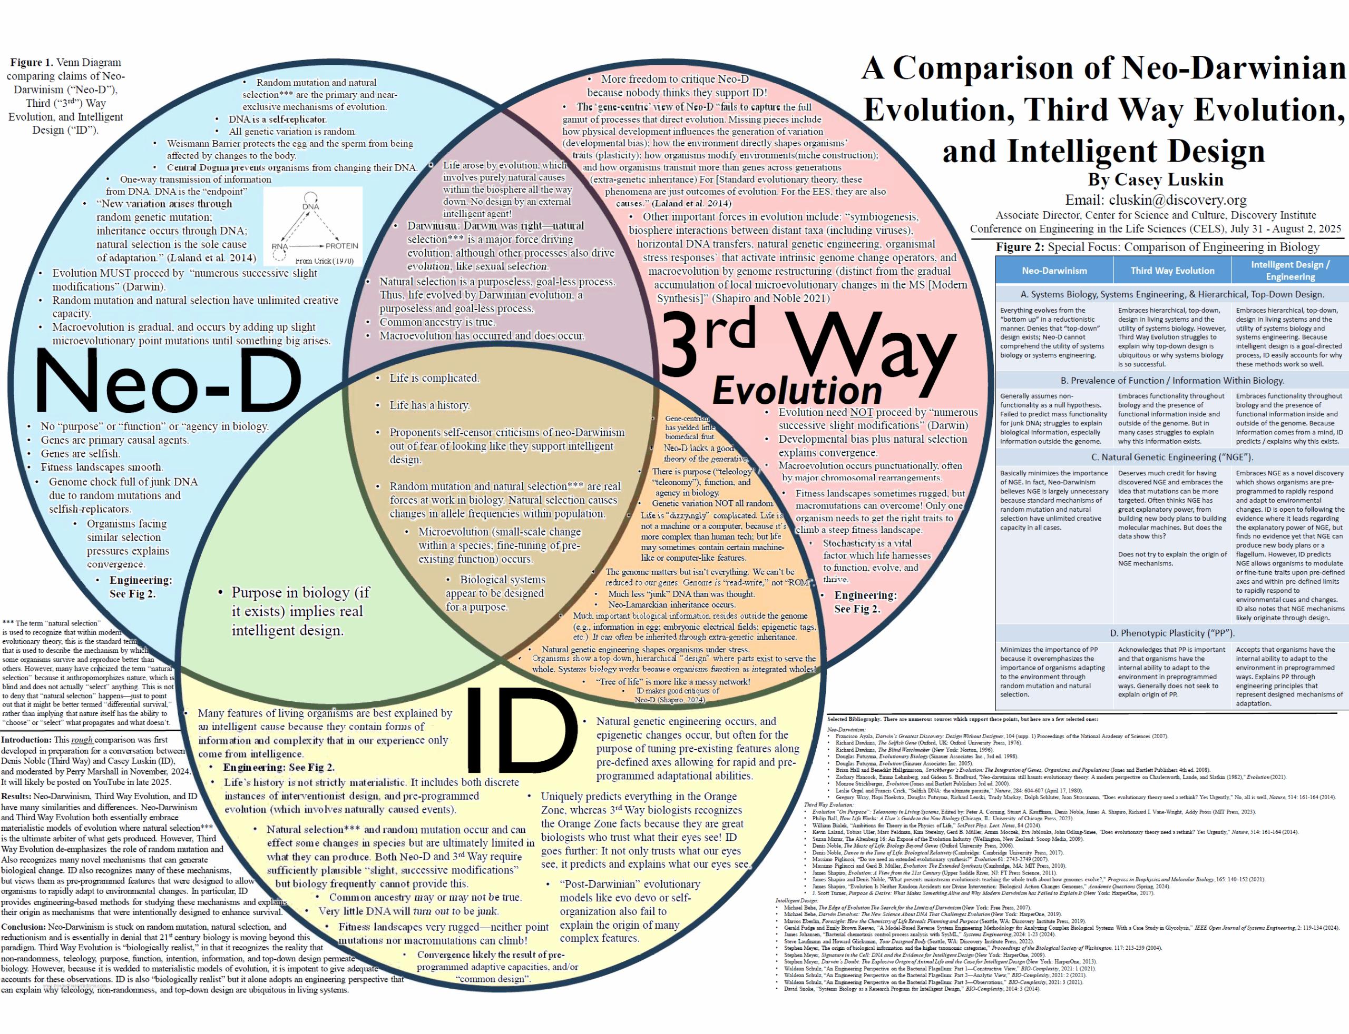
Lecture
SLIDE 4 / 14
Definition and Scope of Environmental Studies
1
Environmental Studies is an interdisciplinary field addressing human-environment interactions.
2
It integrates natural sciences, social sciences, and engineering principles for solutions.
3
The scope includes pollution control, resource management, and biodiversity conservation.
4
It focuses on understanding ecological relationships and feedback loops in nature.
5
The field aims to develop strategies for sustainable development and conservation.
6
Scope extends from local community issues to global climate change challenges.
7
It provides a framework for analyzing environmental problems systematically.
The Venn Diagram | Science and Culture Today
Chandigarh University
4 / 14
Notes:
Environmental Studies is not just biology; it is an interdisciplinary field addressing human-environment interactions. It integrates natural sciences, social sciences, and engineering principles to find solutions. The scope includes pollution control, resource management, and biodiversity conservation. Think of it as a framework for analyzing environmental problems systematically, from local community issues to global climate change challenges.

Slide 5
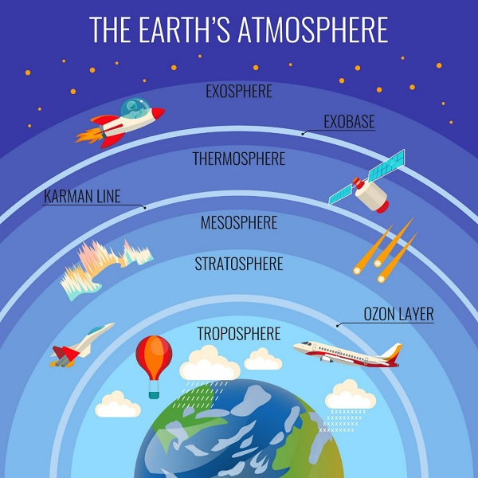
Lecture
SLIDE 5 / 14
Principles of Environmental Risk Assessment
IT INVOLVES FOUR STEPS
hazard identification, dose-response assessment, exposure assessment, and risk characterization.
• Risk assessment identifies hazards and quantifies the probability of adverse effects.
• The process evaluates the likelihood of harm to human health or ecosystems.
• Quantitative risk assessment uses mathematical models to predict potential damage scenarios.
• It helps prioritize environmental management actions based on severity and probability.
• Risk assessment is essential for regulatory compliance and safety planning.
• It transforms uncertain environmental data into actionable decision-making metrics.
Environmental Studies - Ecosystem (source: www.tutorialspoint.com)
Chandigarh University
5 / 14
Notes:
Risk assessment identifies hazards and quantifies the probability of adverse effects. It involves four steps: hazard identification, dose-response assessment, exposure assessment, and risk characterization. The process evaluates the likelihood of harm to human health or ecosystems. It helps prioritize environmental management actions based on severity and probability, transforming uncertain data into actionable metrics.

Slide 6
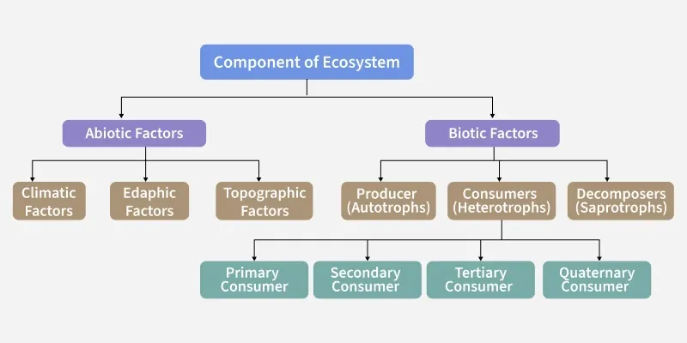
Worked Example
SLIDE 6 / 14
Risk Calculation
GOVERNING EQUATION
Formula: R = P × C
R is the risk index.
EXAMPLE
A chemical spill has a 0.05 probability of occurring annually.
CALCULATION
R = 0.05 × 1000 = 50 units of risk per year.
• Risk (R) is calculated as the product of Probability (P) and Consequence (C).
• The consequence is estimated at 1000 units of ecological damage.
• This value helps compare risks and allocate resources for mitigation.
• Higher risk values indicate a need for immediate regulatory intervention.
Environment vs Ecosystem - GeeksforGeeks (source: media.geeksforgeeks.org)
Chandigarh University
6 / 14
Notes:
Risk is calculated as the product of Probability and Consequence. For example, if a chemical spill has a 0.05 probability of occurring annually and the consequence is 1000 units of damage, the risk is 50 units per year. This value helps compare risks and allocate resources for mitigation. Higher risk values indicate a need for immediate regulatory intervention.

Slide 7
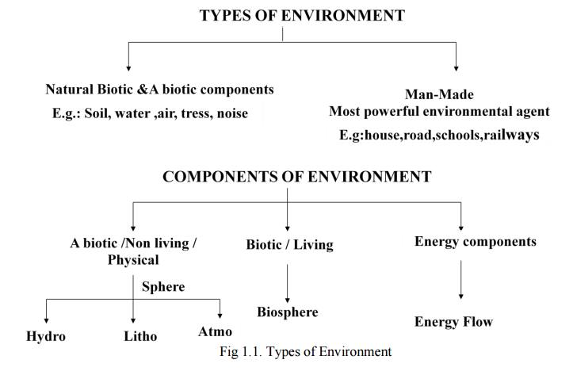
Lecture
SLIDE 7 / 14
Common Pitfalls in Risk Assessment
1
Ignoring low-probability, high-consequence events leads to underestimation of risk.
2
Assuming linear dose-response relationships can be inaccurate for toxins.
3
Overlooking cumulative effects of multiple stressors on ecosystems.
4
Using outdated data for exposure assessment in rapidly changing environments.
5
Failing to account for uncertainty in model parameters and predictions.
6
Neglecting social and economic factors in the risk characterization phase.
7
Relying solely on historical data without considering future climate scenarios.
Concept, Structure, Components of Ecosystem (source: img.brainkart.com)
Chandigarh University
7 / 14
Notes:
Ignoring low-probability, high-consequence events leads to underestimation of risk. Assuming linear dose-response relationships can be inaccurate for toxins. Overlooking cumulative effects of multiple stressors on ecosystems is a common error. Failing to account for uncertainty in model parameters and predictions can lead to flawed conclusions.

Slide 8
Lecture
SLIDE 8 / 14
Genetically Modified Microbes in Environment
1
GM microbes are engineered to degrade pollutants like oil and heavy metals.
2
They enhance bioremediation processes in contaminated soil and water bodies.
3
Significance lies in their ability to break down complex organic compounds.
4
They can be designed to produce biofuels from agricultural waste.
5
Risk involves potential horizontal gene transfer to native microbial populations.
6
Regulatory frameworks ensure containment and monitoring of GM microbe release.
7
They offer a sustainable solution for cleaning industrial waste sites.
Environment vs Ecosystem - GeeksforGeeks (source: media.geeksforgeeks.org)
Chandigarh University
8 / 14
Notes:
GM microbes are engineered to degrade pollutants like oil and heavy metals. They enhance bioremediation processes in contaminated soil and water bodies. Their significance lies in their ability to break down complex organic compounds. However, risk involves potential horizontal gene transfer to native microbial populations, requiring strict regulatory frameworks.

Slide 9
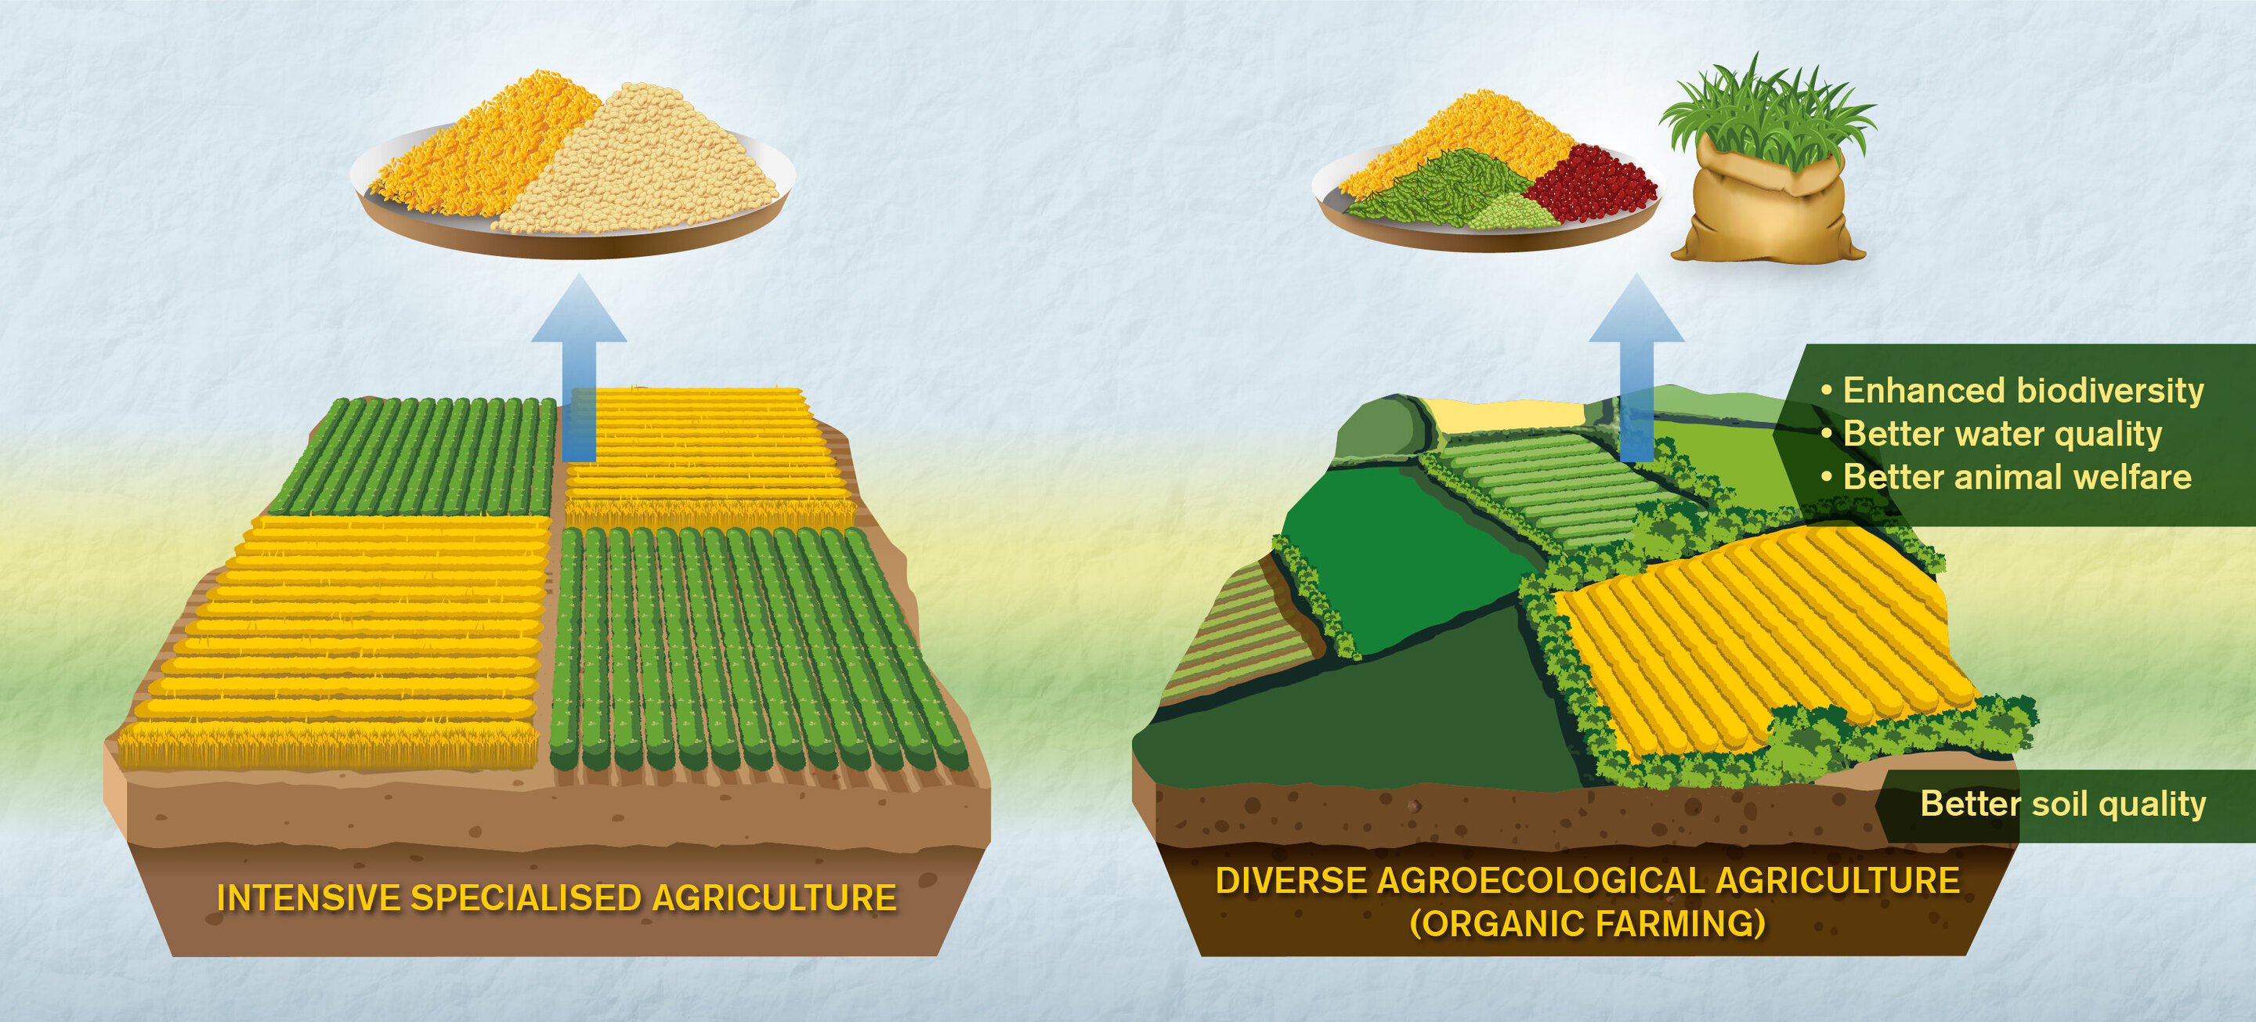
Lecture
SLIDE 9 / 14
Genetically Modified Plants and Animals
1
GM plants are developed for pest resistance and drought tolerance.
2
They reduce the need for chemical pesticides and herbicides in agriculture.
3
GM animals are engineered for improved growth rates and disease resistance.
4
Environmental significance includes potential impacts on non-target species.
5
Gene flow from GM crops to wild relatives is a major concern.
6
They contribute to food security but require rigorous ecological impact studies.
7
Biodiversity conservation is critical when introducing GM organisms into ecosystems.
Source: scx2.b-cdn.net
Chandigarh University
9 / 14
Notes:
GM plants are developed for pest resistance and drought tolerance. They reduce the need for chemical pesticides and herbicides in agriculture. GM animals are engineered for improved growth rates and disease resistance. However, environmental significance includes potential impacts on non-target species, and gene flow from GM crops to wild relatives is a major concern.

Slide 10
Lecture
SLIDE 10 / 14
Integrated Approach to Environmental Study
1
An integrated approach combines scientific, social, and economic perspectives.
2
It ensures holistic solutions rather than isolated technical fixes.
3
Stakeholder engagement is crucial for successful environmental management strategies.
4
Policy-making must be informed by scientific evidence and public input.
5
Cross-sector collaboration enhances the effectiveness of conservation efforts.
6
It addresses root causes of environmental degradation rather than symptoms.
7
Sustainable development goals guide the integrated approach framework.
Environmental Studies - Ecosystem (source: www.tutorialspoint.com)
Chandigarh University
10 / 14
Notes:
An integrated approach combines scientific, social, and economic perspectives. It ensures holistic solutions rather than isolated technical fixes. Stakeholder engagement is crucial for successful environmental management strategies. Policy-making must be informed by scientific evidence and public input to address root causes of environmental degradation.

Slide 11
Lecture
SLIDE 11 / 14
Market for Environmental Study
1
The market includes consulting, monitoring, and remediation services for industries.
2
Demand is driven by stricter environmental regulations and corporate sustainability.
3
Technologies for waste treatment and renewable energy are key growth areas.
4
Environmental impact assessments are mandatory for most large-scale projects.
5
The market values expertise in risk assessment and compliance management.
6
Green technology startups are emerging to address climate change challenges.
7
Investment in environmental study is increasing globally for future-proofing.
Environmental Studies - Ecosystem (source: www.tutorialspoint.com)
Chandigarh University
11 / 14
Notes:
The market includes consulting, monitoring, and remediation services for industries. Demand is driven by stricter environmental regulations and corporate sustainability. Technologies for waste treatment and renewable energy are key growth areas. The market values expertise in risk assessment and compliance management, with investment increasing globally.

Slide 12
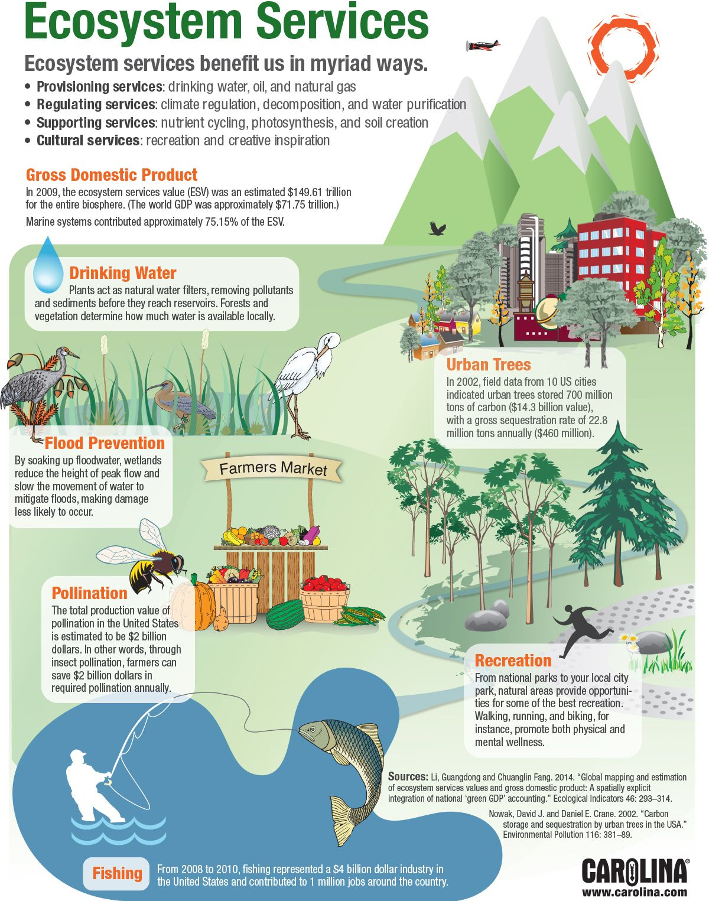
Lecture
SLIDE 12 / 14
Economic Value of Environmental Services
1
Ecosystem services provide billions in economic value annually to society.
2
Pollination, water purification, and carbon sequestration are critical economic drivers.
3
Loss of biodiversity results in significant economic losses for agriculture.
4
Investment in conservation yields high returns through sustainable resource use.
5
Environmental studies quantify these values to guide policy decisions.
6
The market for carbon credits is a direct economic application of study.
7
Sustainable practices reduce long-term costs for businesses and governments.
Source: www.carolina.com
Chandigarh University
12 / 14
Notes:
Ecosystem services provide billions in economic value annually to society. Pollination, water purification, and carbon sequestration are critical economic drivers. Loss of biodiversity results in significant economic losses for agriculture. Investment in conservation yields high returns through sustainable resource use, quantified by environmental studies.

Slide 13
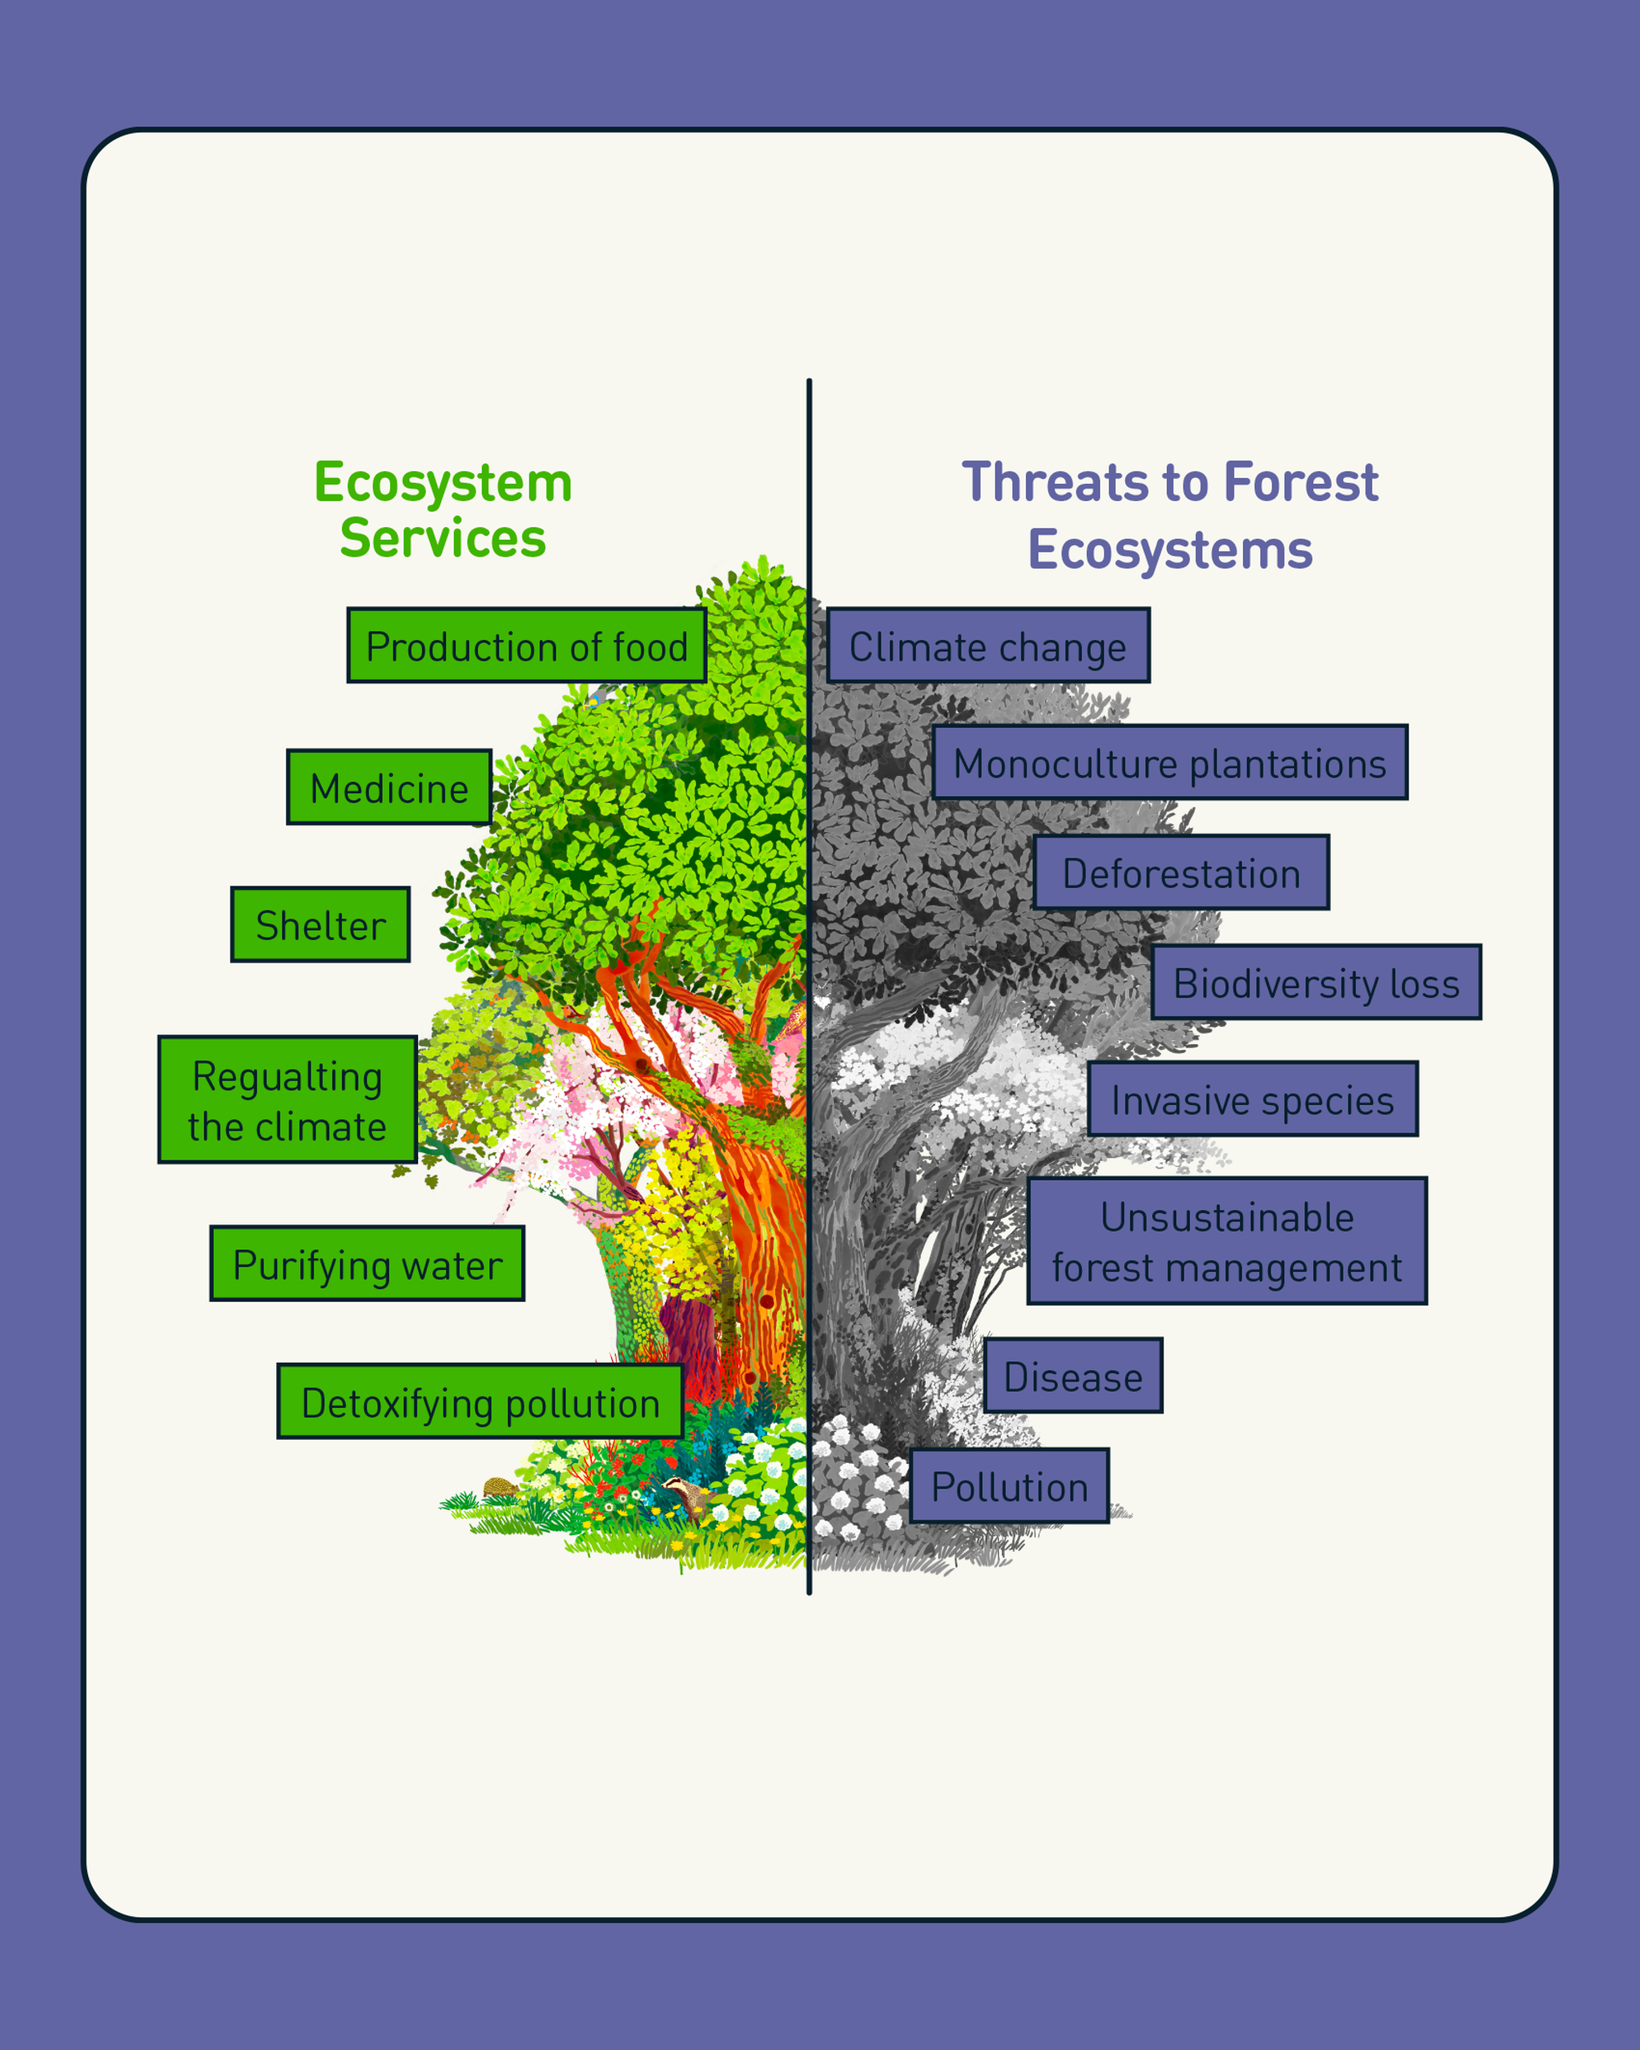
Lecture
SLIDE 13 / 14
Key Takeaways
1
Environmental Studies is an interdisciplinary field essential for sustainable development.
2
Risk assessment provides a quantitative framework for managing environmental hazards.
3
GM organisms offer solutions but require careful ecological risk management.
4
An integrated approach ensures holistic and effective environmental strategies.
5
The environmental study market is growing due to regulatory and economic drivers.
Source: cdn.sanity.io
Chandigarh University
13 / 14
Notes:
Environmental Studies is an interdisciplinary field essential for sustainable development. Risk assessment provides a quantitative framework for managing environmental hazards. GM organisms offer solutions but require careful ecological risk management. An integrated approach ensures holistic and effective environmental strategies, and the market is growing due to regulatory and economic drivers.

Slide 14
Lecture
SLIDE 14 / 14
References
ENVIRONMENTAL STUDIES
From Crisis to Cure — R. Rajagopalan
• Environmental Science and Engineering — Benny Joseph
• Environmental Studies — R.C. Sharma and D. Gurbir Sangha
• Introduction to Environmental Science — Anjaneyulu, Y.
• Environmental Pollution Control Engineering — C.S. Rao
• Textbook of Environmental Studies for undergraduate courses — E. Bharucha
• Environmental Science — S.C. Santra
Chandigarh University
14 / 14
Notes:
These references provide the foundational knowledge for the topics covered today. Benny Joseph's work offers a comprehensive view of environmental science. R.C. Sharma and D. Gurbir Sangha provide detailed insights into environmental studies. Anjaneyulu, C.S. Rao, E. Bharucha, R. Rajagopalan, and S.C. Santra offer specialized perspectives on pollution control and sustainable practices.

